Slide 1
Political science introductory course lecture 8
Marem Buzurtanova
Almaty 2022

Slide 2
Political science introductory course lecture 8
Quantitative research Methods in Social science – Lecture 8 Outline:
Positivism in social science;
qualitative VS quantitative research;
quantitative methods in social science;
independent and dependent variable.

Slide 3
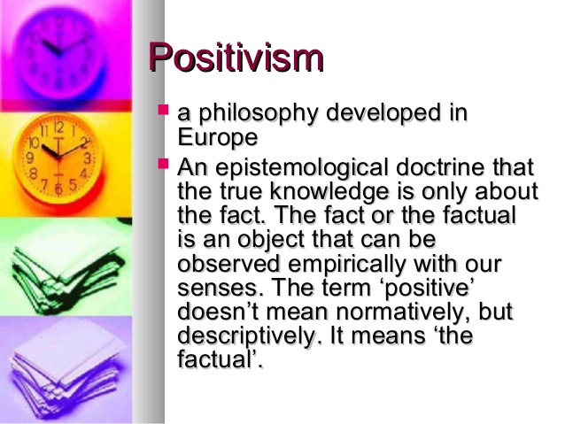
Political science introductory course lecture 8
In social science, antipositivism (also interpretivism, negativism or antinaturalism);
the social cannot be studied with the scientific method of natural sciences,
a different epistemology is required.
the concepts and language that researchers use shape their perceptions of the social world.
Auguste Comte (1798 –1857) and the Vienna Circle of Logical Empiricism (1924 – 1936)

Slide 4


Political science introductory course lecture 8
Qualitative Research VS Quantitative Research
Quantitative research is “explaining phenomena by collecting numerical data that are analysed using mathematically based methods (in particular statistics).” Qualitative research seeks to answer questions about why and how people behave in the way that they do. It provides in-depth information about human behaviour.

Slide 5
Political science introductory course lecture 8
Qualitative Methods | Quantitative Methods
Interview Observation Oral History | Trend Study Cohort Study Panel Study Blind and Double-blind Study
Qualitative research relies on data obtained by the researcher from first-hand observation, interviews, questionnaires, focus groups, participant-observation, recordings made in natural settings, documents, and artifacts. The data are generally nonnumerical. Qualitative methodological frameworks include ethnography, grounded theory, discourse analysis, and interpretative phenomenological analysis. Qualitative research methods used in sociology, anthropology, political science, psychology, social work, and educational research study individuals' understanding of their social reality. | Quantitative research methods emphasise objective measurement and the statistical and mathematical, or numerical analysis of the data collected through polls, surveys, or by manipulating the pre-existing statistical data using computational techniques.

Slide 6
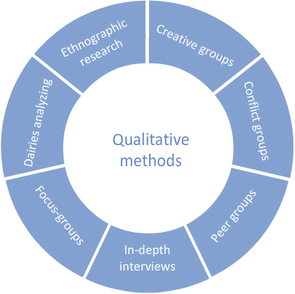

Political science introductory course lecture 8

Slide 7
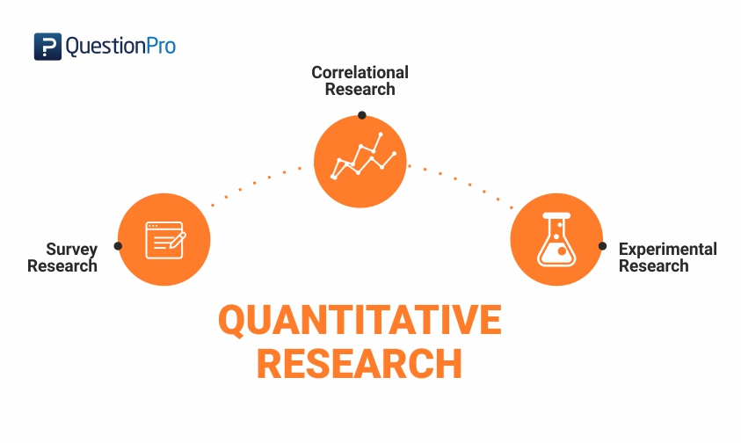
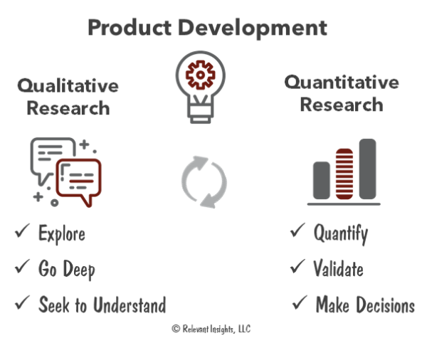
Political science introductory course lecture 8

Slide 8
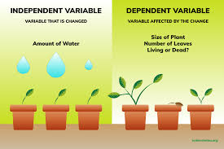
Political science introductory course lecture 8
The independent variable is the variable the experimenter changes or controls and is assumed to have a direct effect on the dependent variable. ... The dependent variable is the variable being tested and measured in an experiment, and is 'dependent' on the independent variable.

Slide 9
Political science introductory course lecture 8
In the social sciences, independent variables are typically thought of as being the cause, and dependent variables are often seen as being the effect. The independent variable, in other words, affects the dependent variable in some way.
Sometimes, the causal relationship between two variables can be unclear. Consider the relationship between religious affiliation and attitudes toward abortion. Which is the independent variable? Let's say, for example, that members of a given faith are opposed to abortion. Can we assume that the church's teachings influenced its members' attitudes toward abortion? Or did the members choose that church because they were already opposed to abortion?
When two phenomena appear to be occurring at the same time, social scientists need to come up with their own theories about how the two variables interact. (see https://soc.utah.edu/sociology3112/basics.php )

